Slide 1
DeepDiabetic: An Identification System of Diabetic Eye Diseases Using Deep Neural Networks

Slide 2
Abstract
Diabetic eye diseases, such as diabetic retinopathy, are leading causes of vision impairment worldwide, necessitating early and accurate diagnosis. This paper presents DeepDiabetic, an automated identification system designed to detect diabetic eye diseases from retinal images using deep neural networks. By leveraging advanced convolutional neural network (CNN) architectures, DeepDiabetic analyzes fundus images to classify and identify disease stages with high accuracy and efficiency. Experimental results demonstrate that the system achieves robust performance in distinguishing diabetic eye conditions, enabling timely intervention and improving patient outcomes.

Slide 3
Introduction
Diabetic eye diseases, including diabetic retinopathy and diabetic macular edema, are among the leading causes of vision impairment and blindness worldwide. Early detection and accurate diagnosis are critical to preventing severe vision loss and improving patient outcomes. However, manual diagnosis through fundus examination is often time-consuming, requires specialized expertise, and is prone to subjective variability.
With the rapid advancements in artificial intelligence, particularly deep learning, automated systems have shown great promise in medical image analysis. Deep neural networks, known for their ability to learn complex patterns from large datasets, offer a powerful tool for identifying subtle features of diabetic eye diseases that may be missed by traditional methods.

Slide 4
Literature servvey
Importance of Early Detection of Diabetic Eye Diseases: Diabetic eye diseases, such as diabetic retinopathy, are leading causes of blindness worldwide. Early diagnosis is crucial to prevent vision loss, and automated systems can help address the shortage of specialists.
Role of Deep Neural Networks in Medical Image Analysis: Deep learning, especially convolutional neural networks (CNNs), has revolutionized medical imaging by enabling automated and accurate detection of diseases from retinal images, outperforming traditional machine learning methods.

Slide 5
Existing System
Diabetic eye diseases, such as diabetic retinopathy and diabetic macular edema, are among the leading causes of vision impairment and blindness worldwide. Early detection and timely treatment of these conditions are critical to prevent severe vision loss. Traditional diagnosis relies heavily on manual examination of retinal images by ophthalmologists, which can be time-consuming, subjective, and prone to errors due to human fatigue or variability in expertise. Moreover, in many regions, there is a shortage of trained specialists, which limits access to timely diagnosis and treatment. Existing computer-aided diagnostic tools have attempted to address these challenges but often suffer from limited accuracy and generalizability due to reliance on handcrafted features and classical machine learning methods.

Slide 6
Drawbacks
• Manual Diagnosis Limitations: Traditional diagnosis of diabetic eye diseases (like diabetic retinopathy) relies heavily on manual examination of retinal images by ophthalmologists, which is time-consuming, labor-intensive, and subject to human error.
• Low Accuracy and Consistency: Existing automated systems may use conventional machine learning methods which often require handcrafted features and may not capture the complex patterns in retinal images well, leading to lower accuracy.

Slide 7
Proposed System
To overcome the limitations of the existing approaches, the proposed system, "Deep Diabetic," leverages the power of deep neural networks to automatically identify diabetic eye diseases from retinal images with high accuracy and efficiency. Deep learning models, especially convolutional neural networks (CNNs), have demonstrated superior capability in learning complex patterns and features directly from image data, surpassing traditional methods. By integrating these advanced techniques, the system can provide consistent, rapid, and objective diagnoses, reducing dependency on specialist availability and human error. This approach aims to improve early detection rates, facilitate better patient management, and ultimately help prevent blindness caused by diabetic eye diseases, making it a crucial advancement in diabetic healthcare technology.

Slide 8
Advantages
• Deep Neural Networks (DNN) for Higher Accuracy: By leveraging deep learning, specifically convolutional neural networks (CNNs), the system can automatically learn complex features from raw retinal images, improving accuracy and robustness in detecting diabetic eye diseases.
• Faster and Automated Diagnosis: The system can quickly analyze images and provide immediate results, facilitating early detection and timely treatment.

Slide 9
HARDWARE REQUIREMENTS:
• System : Pentium IV 2.4 GHz.
• Hard Disk : 40 GB.
• Ram : 512 Mb.

Slide 10
SOFTWARE REQUIREMENTS:
• Operating system : Windows.
• Coding Language : python.

Slide 11
Modules
1. Data Acquisition Module
2. Data Preprocessing Module
3. Feature Extraction Module
4. Deep Neural Network Module
5. Model Training and Validation Module
6. Disease Classification Module
7. User Interface Module
8. System Evaluation Module
9. Deployment Module

Slide 12
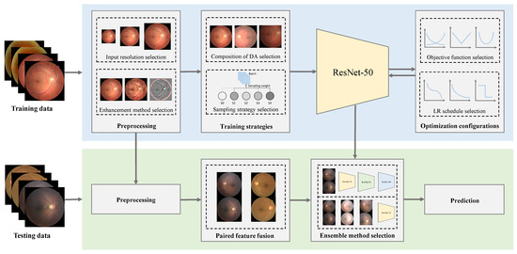
System Architecture:

Slide 13
UML
Class Diagram:

Slide 14
Use case Diagram:

Slide 15
Sequence Diagram:

Slide 16
Collaboration Diagram:

Slide 17
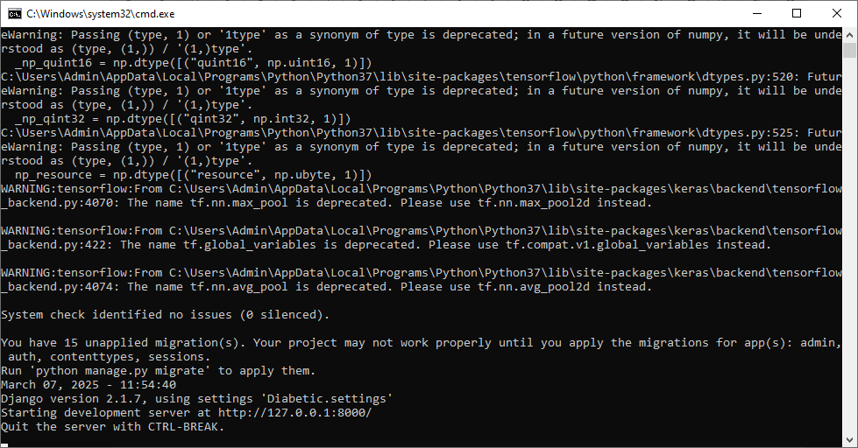

Slide 18
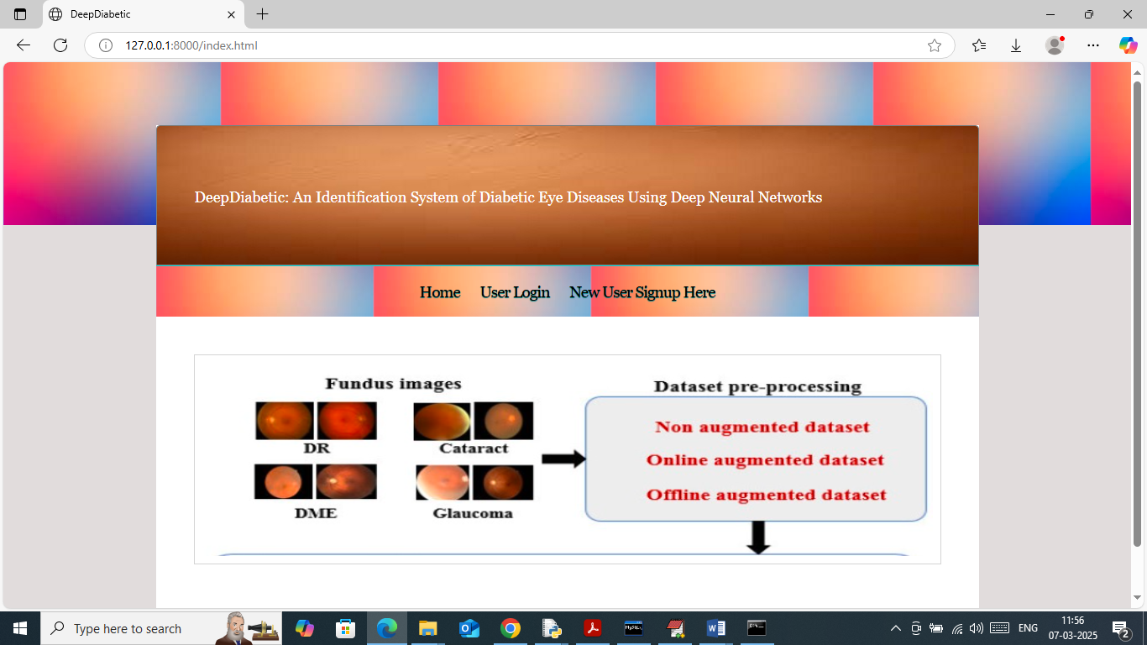

Slide 19
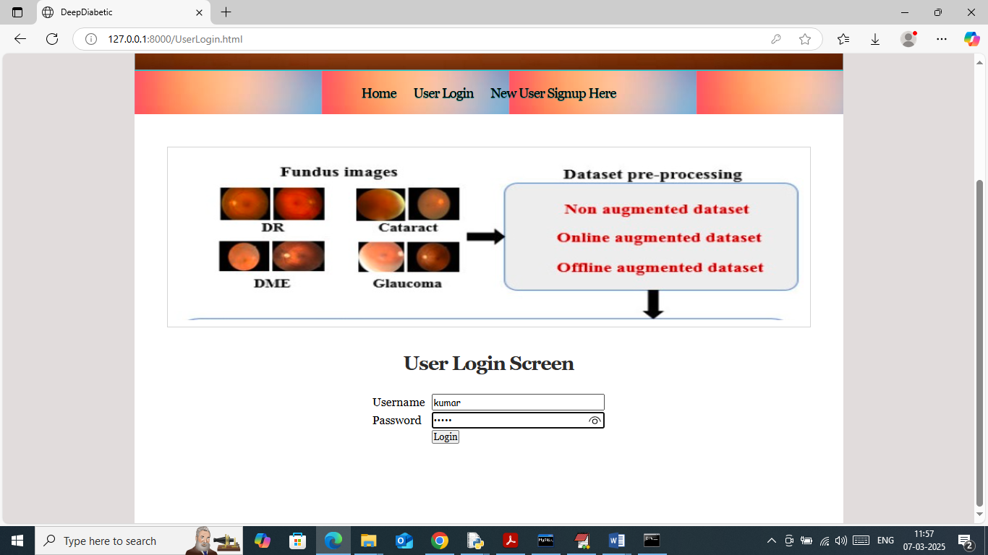

Slide 20
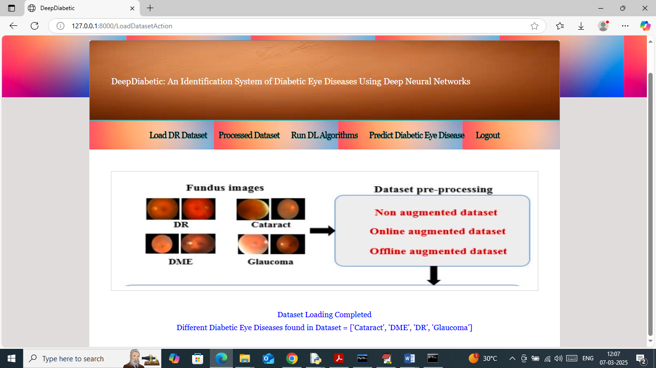

Slide 21
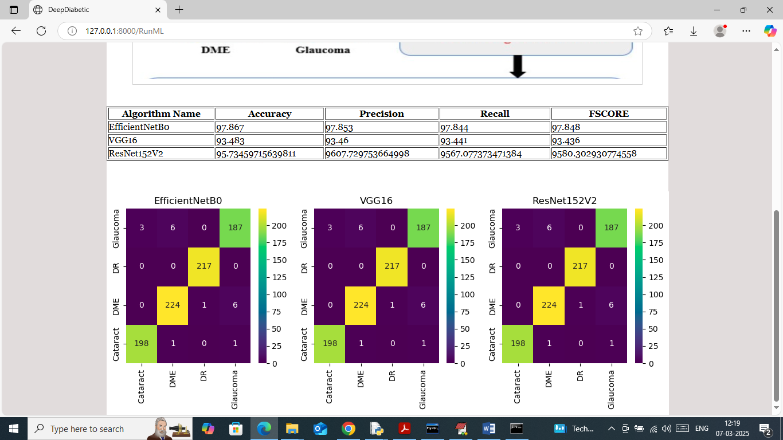

Slide 22
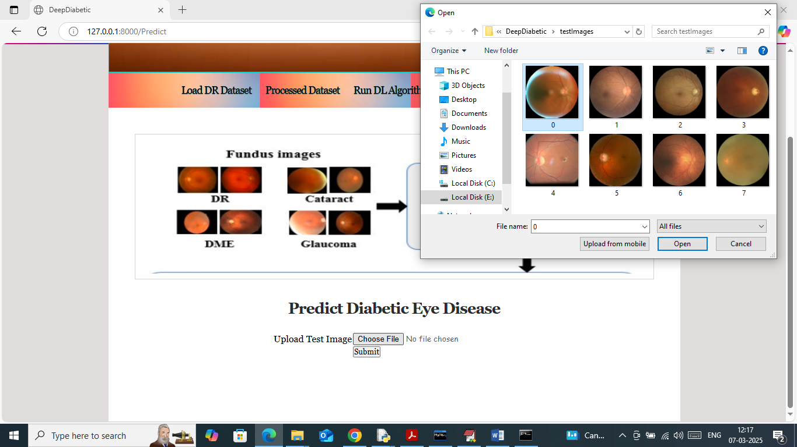

Slide 23
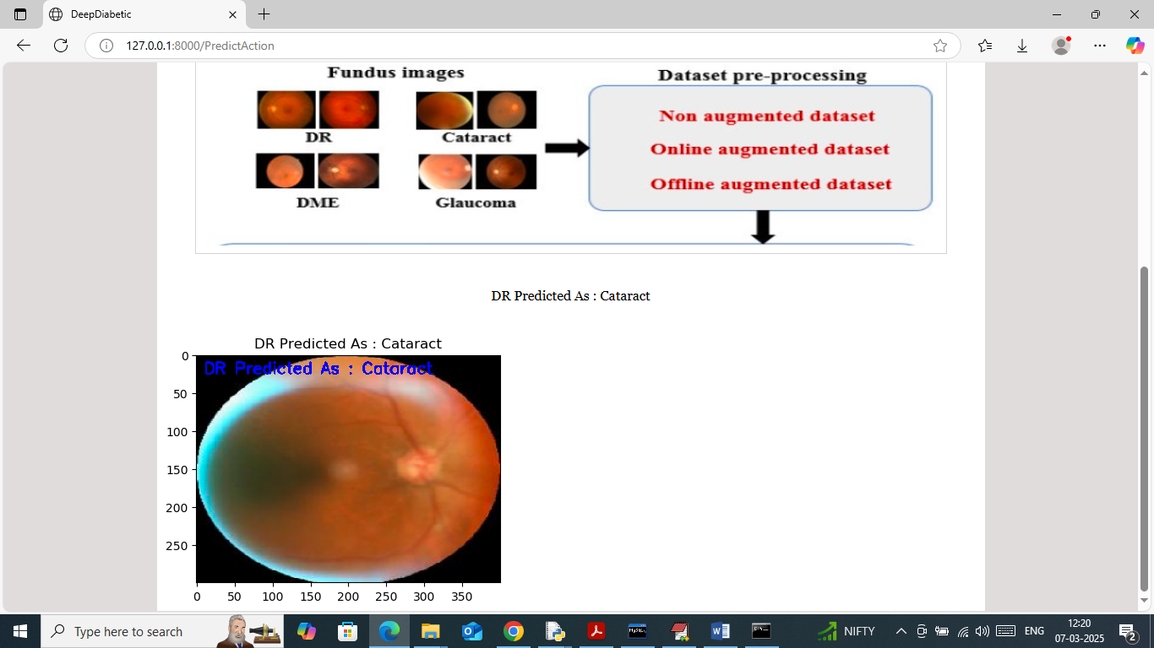

Slide 24
Conclusion
This study presents Deep Diabetic, a deep neural network-based identification system designed to detect diabetic eye diseases from retinal images with high accuracy and reliability. The system leverages advanced convolutional neural networks to automatically extract and classify relevant features, outperforming traditional machine learning methods. Experimental results demonstrate the system’s robustness and potential as an effective screening tool in clinical settings. By providing a fast and accurate diagnostic aid, Deep Diabetic can help bridge the gap in diabetic eye disease screening, especially in regions with limited access to specialized care, thereby contributing to early intervention and better patient outcomes.

Slide 25
Future work
Future work will focus on expanding the dataset to include a wider variety of diabetic eye disease stages and different imaging conditions to improve the model’s generalizability. Additionally, integrating multi-modal data such as patient history and other diagnostic tests could enhance diagnostic accuracy. Real-time deployment on mobile and web platforms will be explored to enable widespread accessibility and usability in remote or underserved areas. Furthermore, incorporating explainable AI techniques will help clinicians understand the model’s decisions, fostering trust and facilitating integration into clinical workflows. Continuous refinement and validation of the system with larger clinical trials are essential steps towards its adoption as a standard diagnostic tool.

Slide 26
Reference
• Gulshan, V., Peng, L., Coram, M., et al. (2016). Development and validation of a deep learning algorithm for detection of diabetic retinopathy in retinal fundus photographs. JAMA, 316(22), 2402–2410. https://doi.org/10.1001/jama.2016.17216
• Ting, D. S. W., Cheung, C. Y., Lim, G., et al. (2017). Development and validation of a deep learning system for diabetic retinopathy and related eye diseases using retinal images from multiethnic populations with diabetes. JAMA, 318(22), 2211–2223. https://doi.org/10.1001/jama.2017.18152
• Pratt, H., Coenen, F., Broadbent, D. M., et al. (2016). Convolutional neural networks for diabetic retinopathy. Procedia Computer Science, 90, 200–205. https://doi.org/10.1016/j.procs.2016.07.014

Slide 27
THANK YOU

